Slide 1

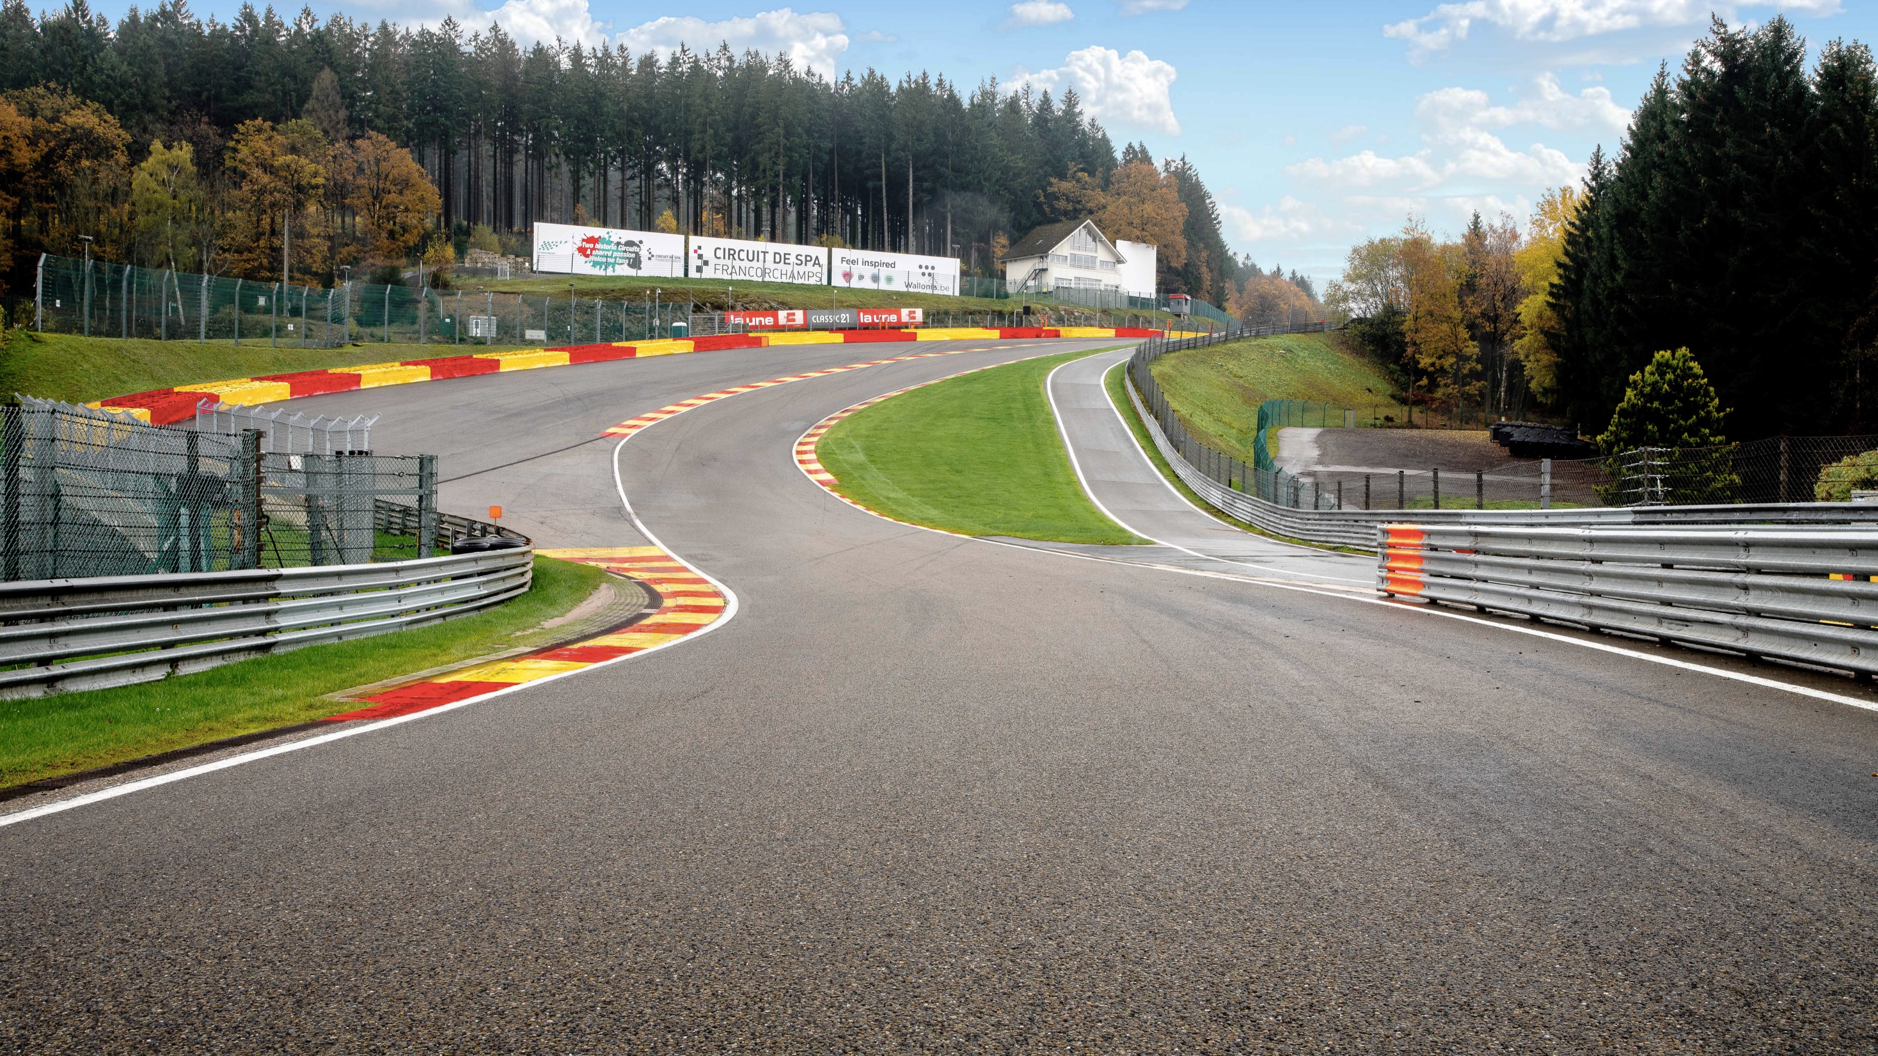
FORMULA 1 PERFORMANCE METRICS:
DRIVERS, TEAMS AND CIRCUITS
ARE YOU READY TO RACE..?

Slide 2


DAB-201
Data Visualisation and Reporting
SPA-FRANCORCHAMPS
Date : 03/12/2021
Paras Godhani
Indu Sanjana
Emmanuel Araoyinbo
TEAM MEMEBERS

Slide 3
Motivation for the topic.
History of F1.
Visual of Car and Circuit.
Visual of pit stop
Charts of Success and Challenges
Basic Information
Top performing drivers by their points
Maximum and minimum speed of car
F1 circuit across countries
Top F1 constructors
Total number of races per circuit
Source of the Data.
Summary.
Final greeting.
SPA-FRANCORCHAMPS
TABLE OF CONTENTS

Slide 4
SPA-FRANCORCHAMPS
The performance metrics in this dashboard highlight the pursuit of excellence by drivers, constructors, and teams.
From mastering high speeds to adapting across global circuits, F1 demonstrates the importance of data-driven decisions, collaboration, and continuous improvement.
It inspires us to push boundaries, embrace challenges, and strive for greatness in any field.
MOTIVATION FOR TOPIC

Slide 5
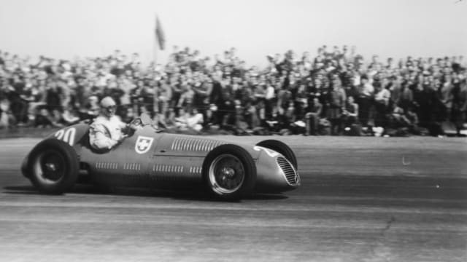
Formula One, commonly known as Formula 1 or F1, is the highest international racing class for open-wheel single-seater formula racing cars sanctioned by the Fédération Internationale de l'Automobile (FIA).
The first racing event was held in 1925.
A Formula One season consists of a series of races, known as Grands Prix. Grands Prix take place in multiple countries and continents on either purpose-built circuits or closed roads.
Ten teams entered for the Formula One World Championship, each entering two cars for a total of twenty cars
The race consists of 3 rounds :
Practice - to understand the track and weather.
Qualifying - to decide grid line for race
Final race
SPA-FRANCORCHAMPS
HISTORY

Slide 6
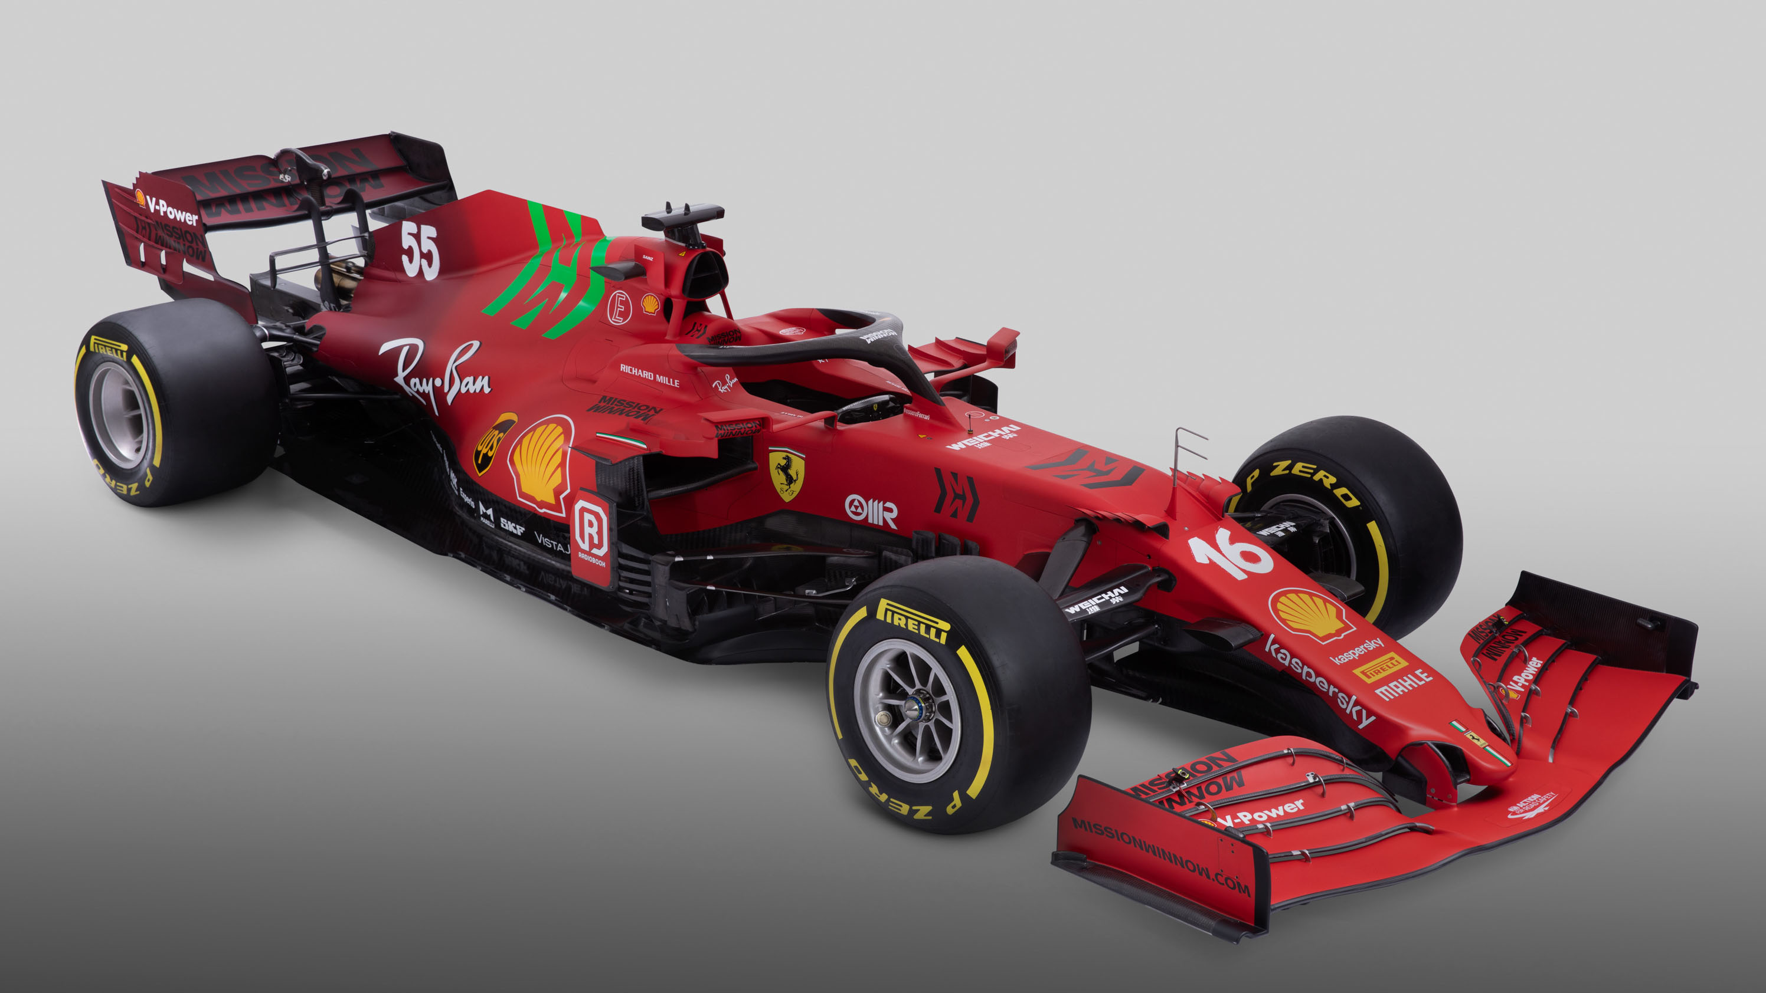
SPA-FRANCORCHAMPS
VISUAL OF CAR

Slide 7
Circuit Length
7.004 km
SPA-FRANCORCHAMPS
The first racing event was held in 1925.
SPEED TRAP
DRS
DETECTION
ZONE 1
Number of laps
44
DRS
DETECTION
ZONE 2
Lap record
1:46.286
VISUAL OF CIRCUIT
(Example of Circuit of Belgium )

Slide 8
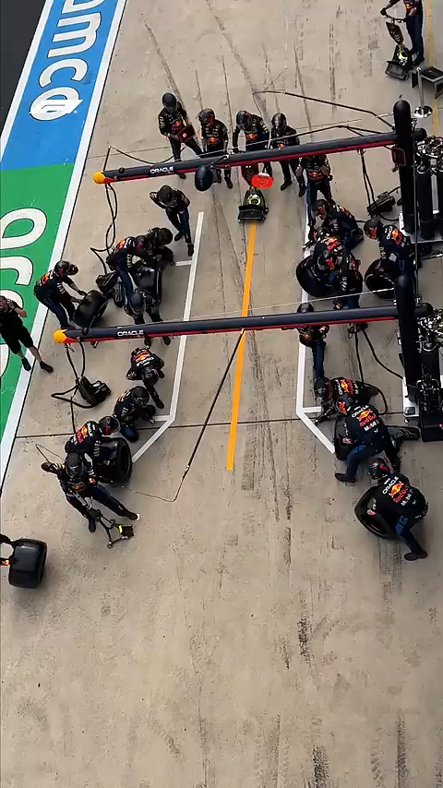
SPA-FRANCORCHAMPS
PIT STOP

Slide 9
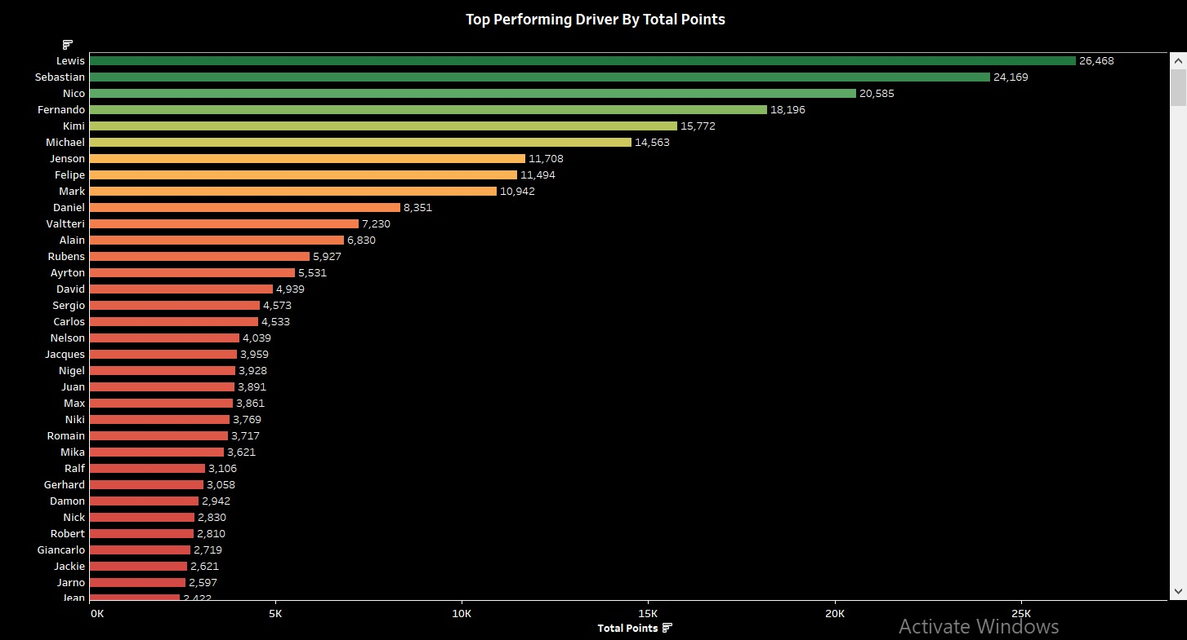
Successes:
Clear Ranking of Top Drivers
Performance Highlights Across Eras
Comprehensive Data Presentation
Challenges:
Overcrowding of Lower-Tier Drivers:
Limited Insights into Driving Conditions
Static Visualization
The Top Performing Driver By Total Points

Slide 10
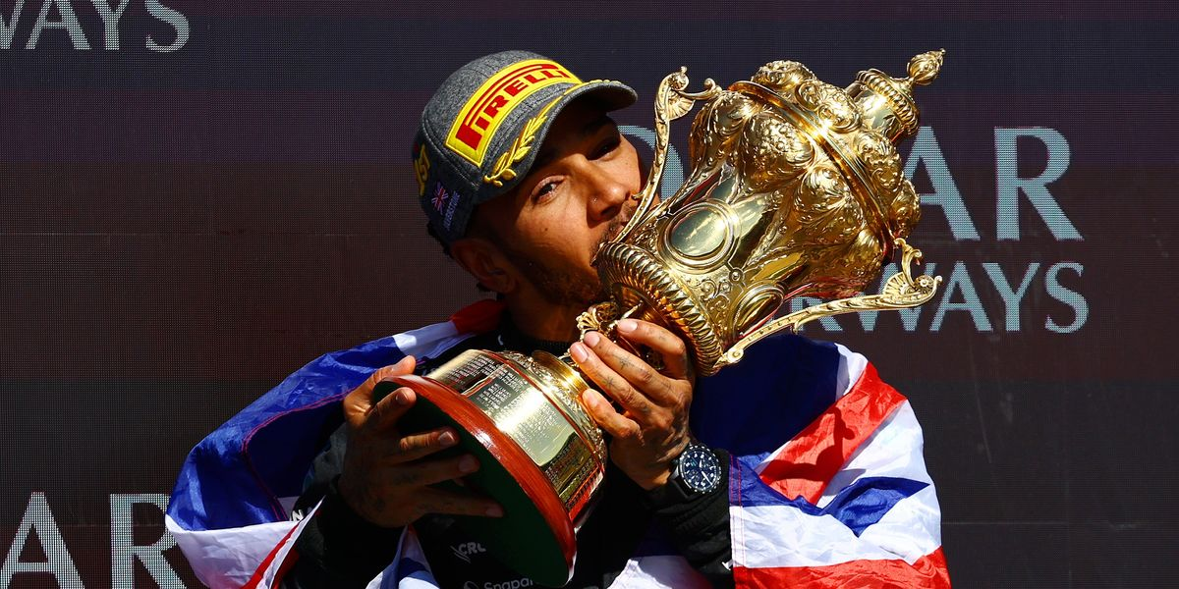
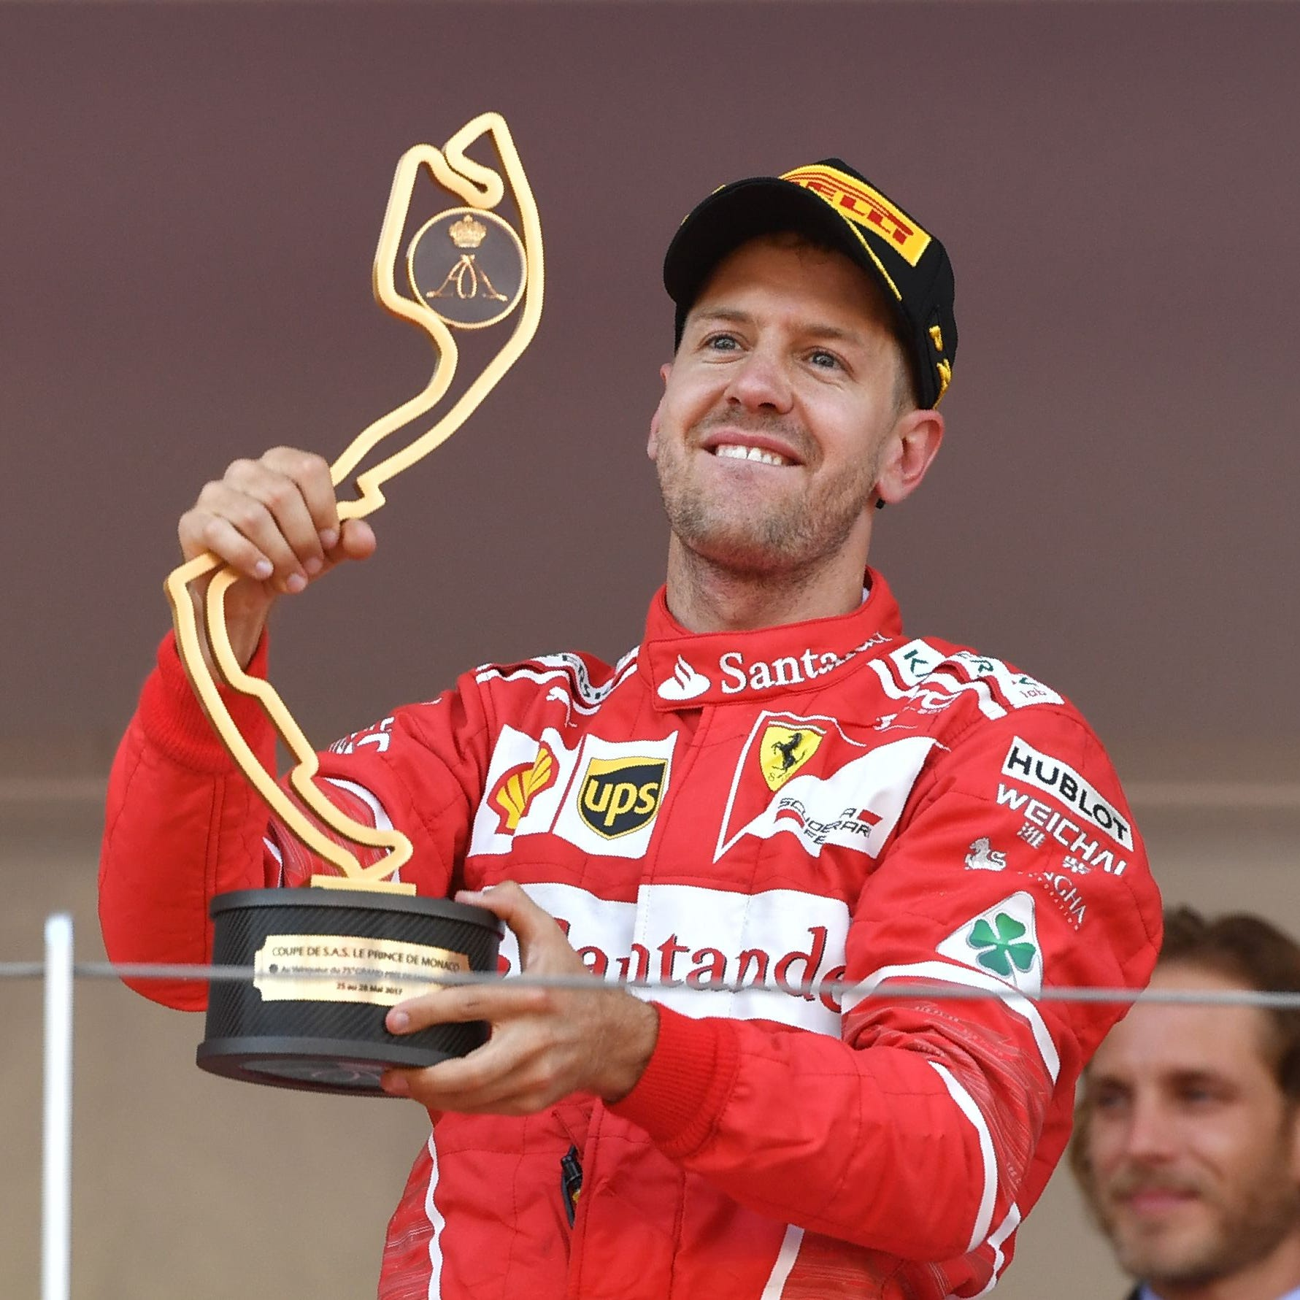

Lewis Hamilton
Sebastian Vettel
Nico Hulkenberg
TOP THREE RACERS

Slide 11
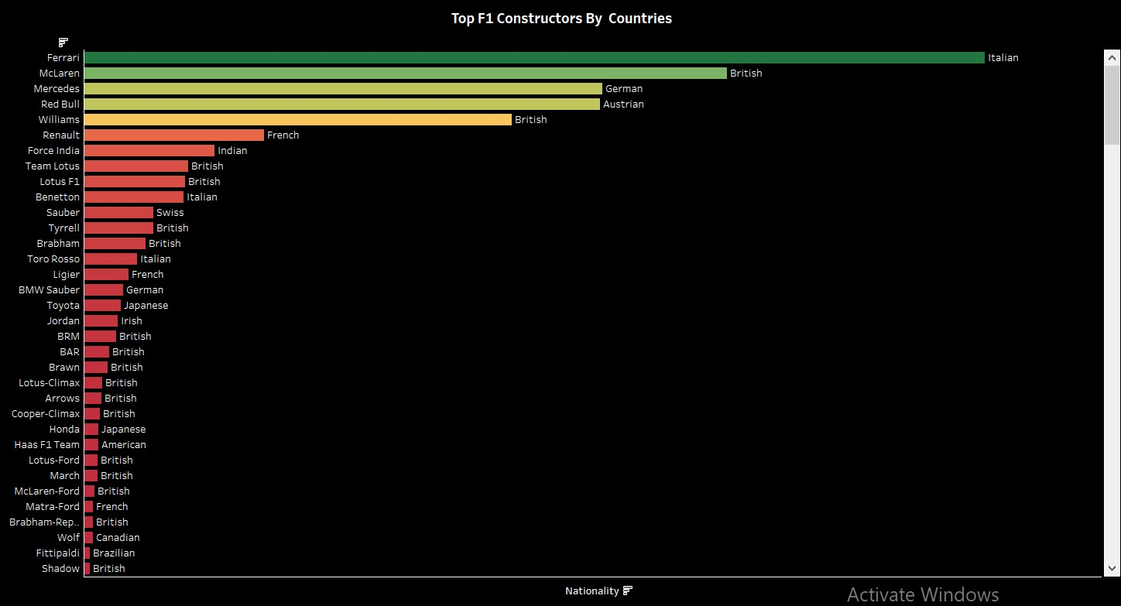
Successes:
Comprehensive Inclusion of Constructors:
Global Representation:
Visual Clarity on Performance Hierarchy:
Balance Between History and Modern Teams
Color-Coded Nationality Labels
Challenges:
Overcrowded Visualization
Point Disparity
Time Context Missing
Potential Confusion with Similar Names
Limited Depth on Metrics

Slide 12
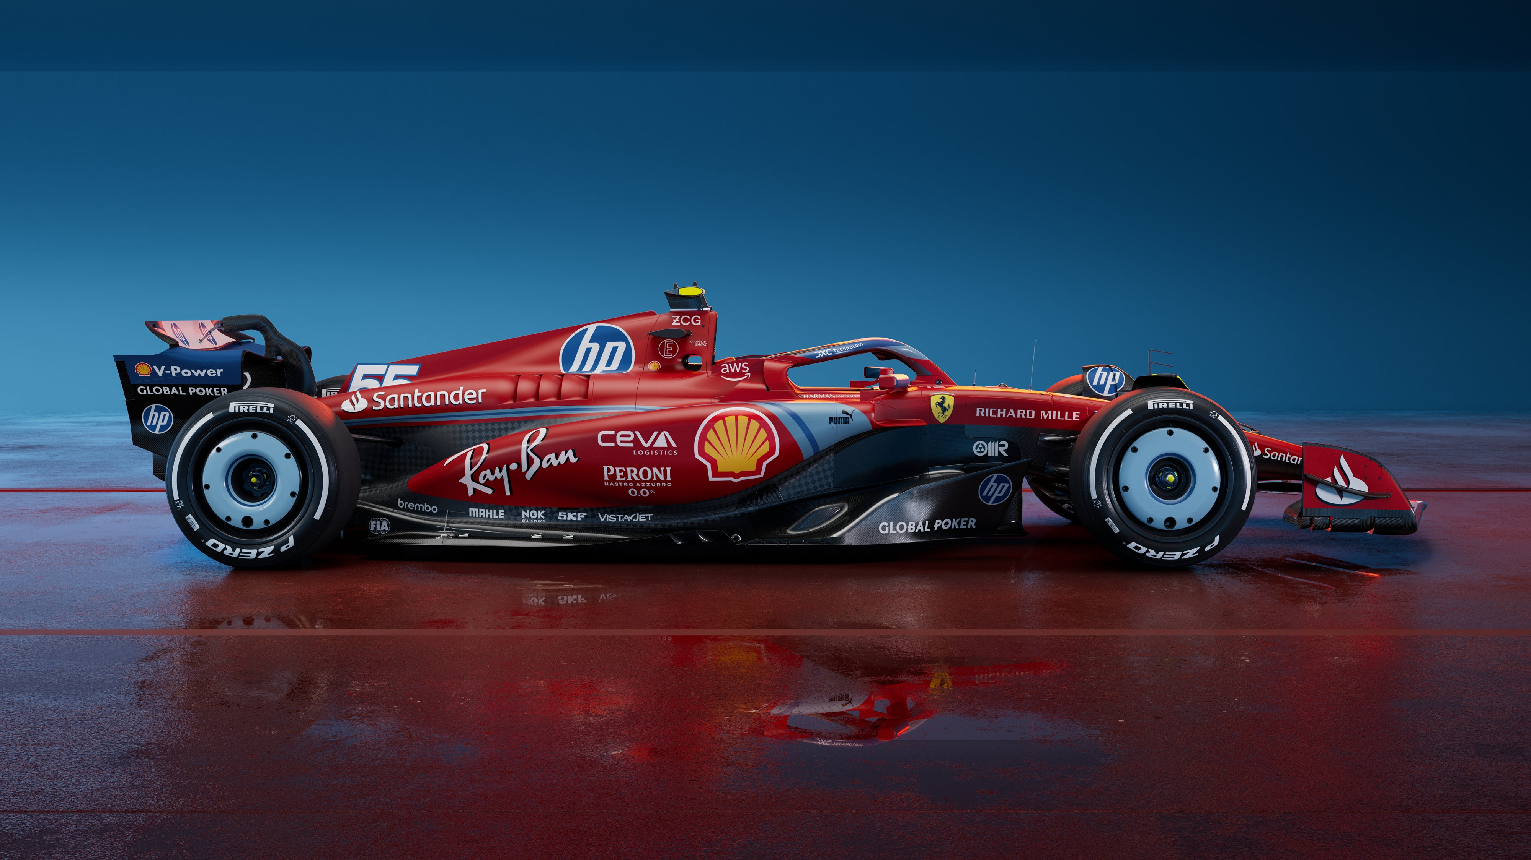
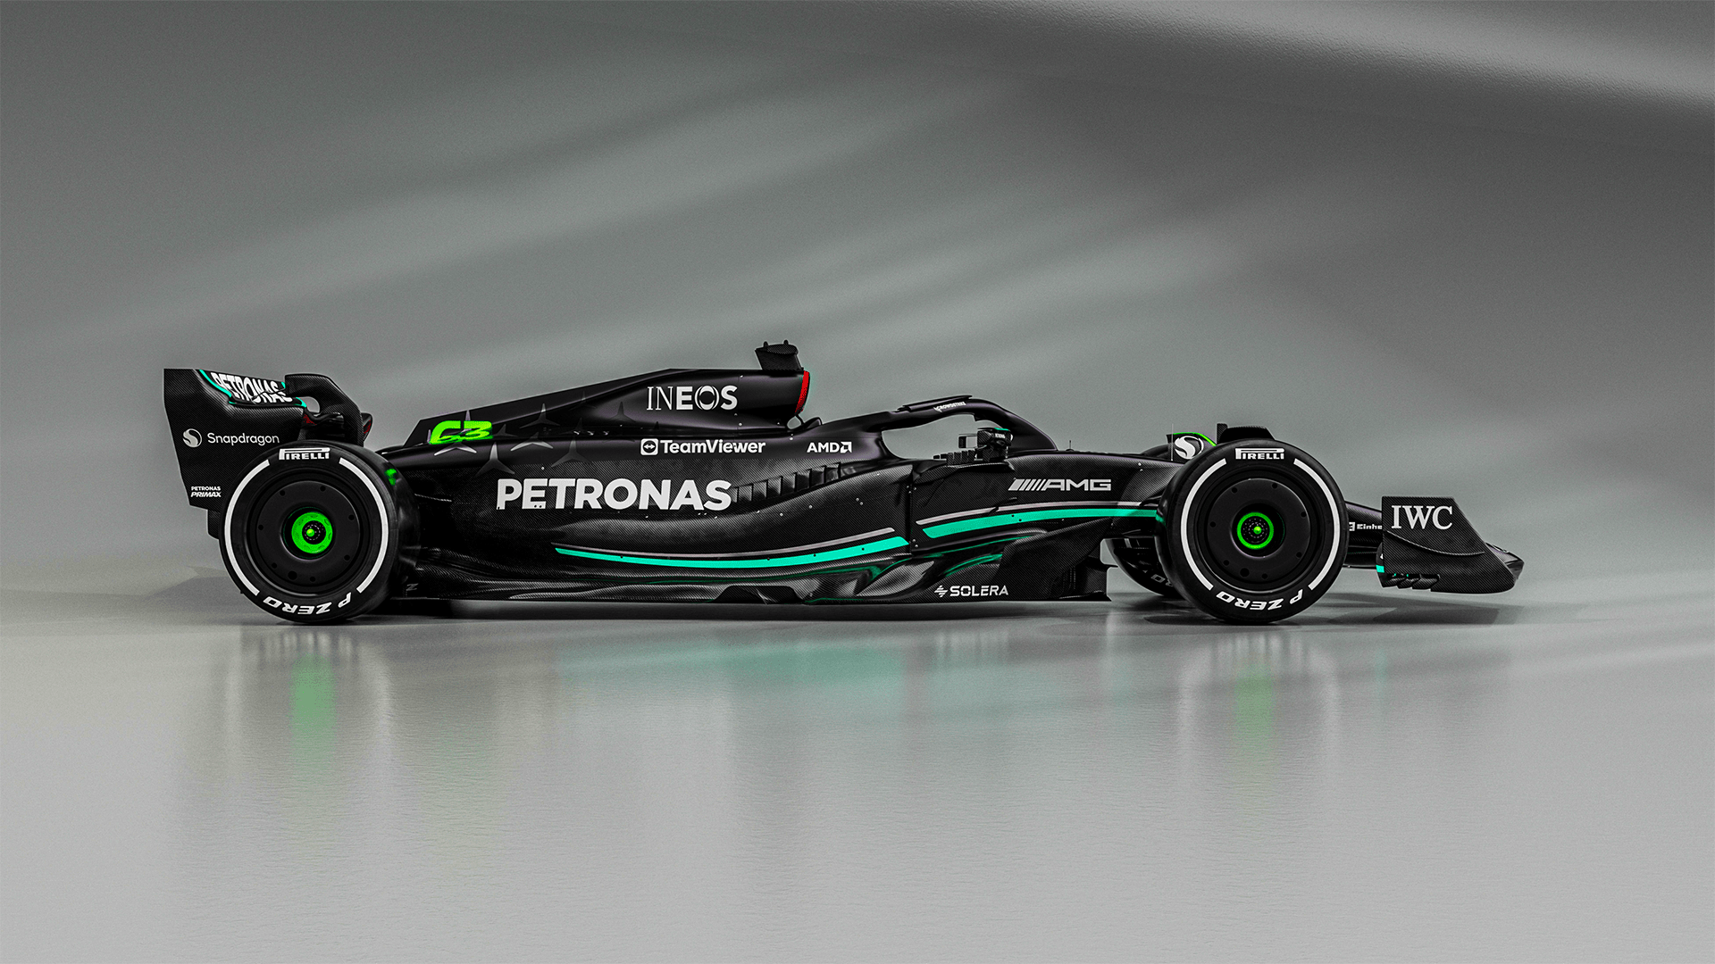
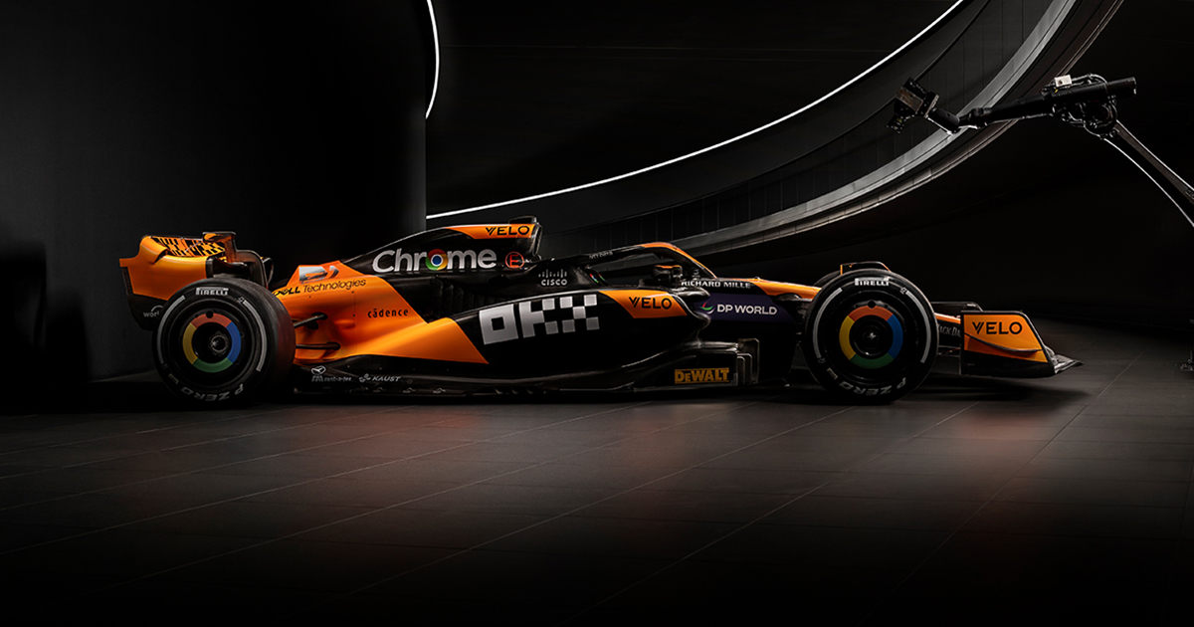
Ferrari
Mercedes
McLaren

Slide 13
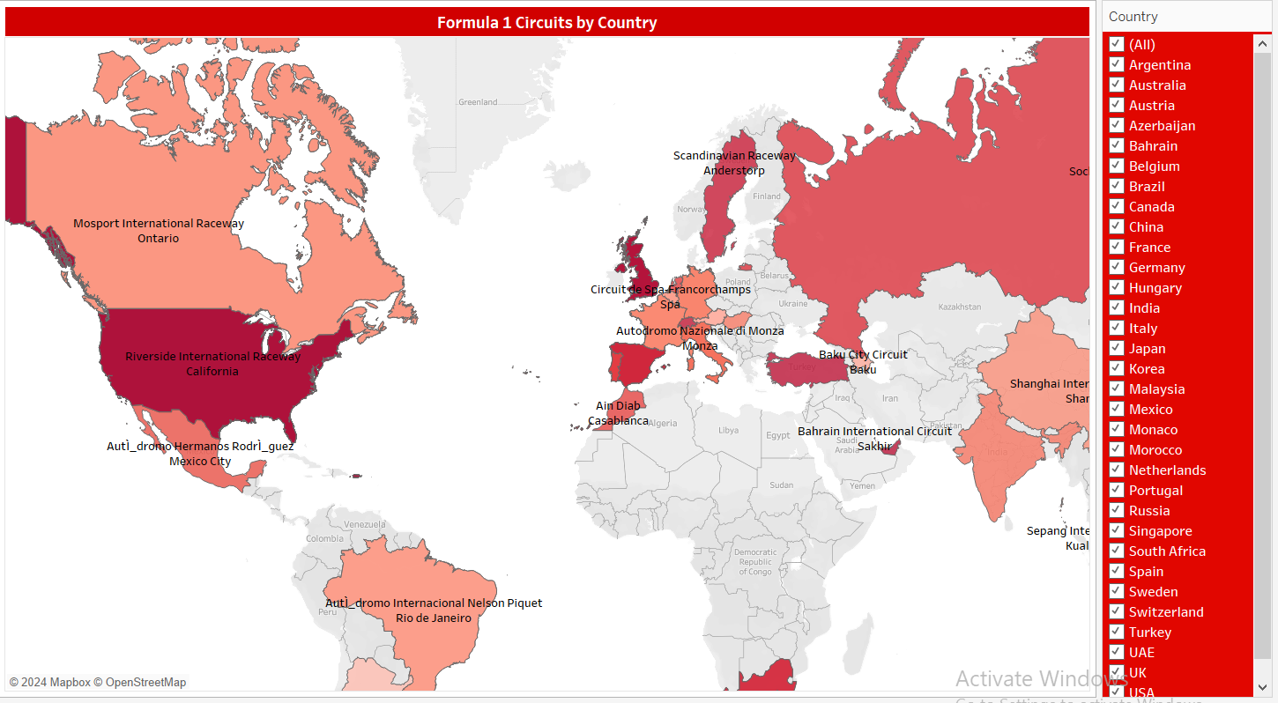
Successes:
Wide Geographic
Diversity in Racing Cultures
Strategic Placement of Races
Iconic Tracks Across Countries
Global Brand Building
Challenges:
Uneven Geographic Distribution
Accessibility and Logistics
Sustainability Concerns
Financial Barriers for Host Countries
Loss of Historical Tracks

Slide 14
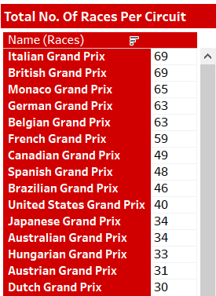
Successes:
Iconic circuits like the Italian and British Grand Prix lead with 69 races, showcasing F1's legacy.
Key locations such as Monaco (65 races) maintain consistency and prestige.
F1's global presence spans continents, reaching diverse audiences.
Inclusion of modern circuits like Abu Dhabi reflects expansion into new markets.
Historical circuits, like South African and Portuguese Grand Prix, highlight F1's legacy.
Challenges:
Uneven utilization, with circuits like Moroccan and Dallas hosting only one race.
Balancing new circuits with classic ones to retain traditional fans.
Underrepresentation in regions like Africa limits global reach.
Preserving and modernizing legacy tracks like Monaco is critical.
Sustainability concerns arise with short-lived circuits like Caesars Palace Grand Prix.

Slide 15
Kaggle :
Dataset Link : https://www.kaggle.com/datasets/rohanrao/formula-1-world-championship-1950-2020
SOURCE OF THE DATA

Slide 16
Information on F1
Total Drivers
Total Constructors
Circuits
Performance Stats :
Top drivers and constructors
Average lap time
Average pit stop duration
Speed of car over years
Geographical Insights:
Races held worldwide
constructor’s dominance
SUMMARY

Slide 17
THANK YOU FOR YOUR JOURNEY.
Any queries?

